Slide 1
Overview of use of routinely collected health data in trials and an introduction to the 3 topic areas covered in the workshop
Ian Ford
Director, Robertson Centre for Biostatistics
and Glasgow Clinical Trials Unit

Slide 2
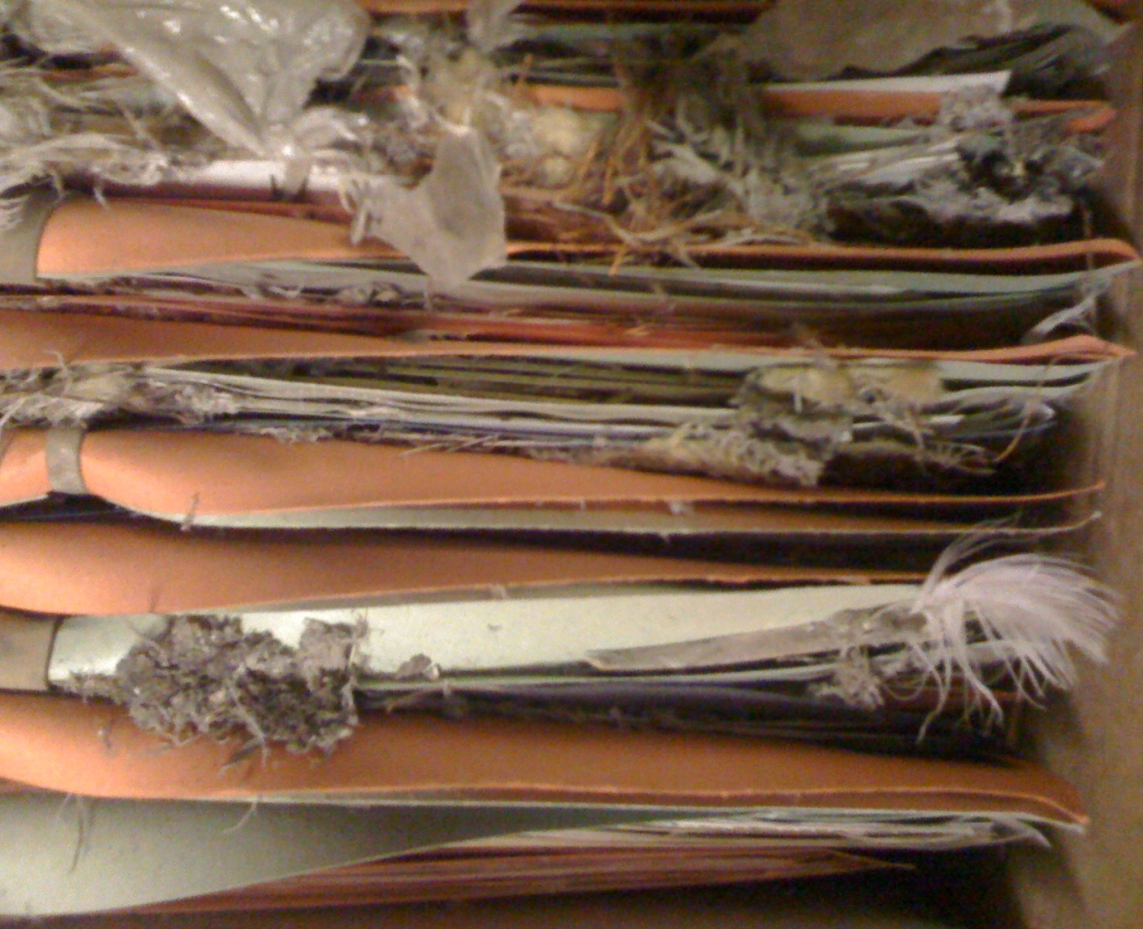
Data quality
The old ways?

Slide 3
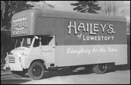
Information transfer: former
The old ways?

Slide 4
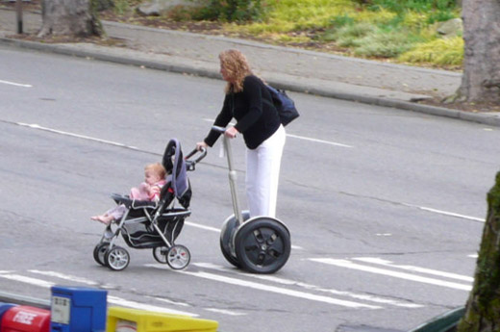
New ways of doing things
Newer ways of working

Slide 5
Study Portal
Newer ways of working
Sponsor
Appoint
committees
Pharmacovigilance
Site setup &
administration
Monitoring
Trial management
Views data and
study reports
Trial Site
IDMC
Research Nurse
Dissemination
of data
Enters data
Endpoints Committee
WEB portal
Randomisation
adjudication
Study co-ordinator
Views data
Glasgow Clinical Trials Unit
Study
Database
Web portal development
& maintenance
Data
Management
Statistical
analysis

Slide 6
Opportunity
Mothers ante-natal records
Maternity
Neonatal record
Register birth - NHS number
Register with GP - CHI
GP Appointments
Outpatients
A&E attendance
General hospital admission
Prescribing
Cancer registration
Cancer treatment
Community care
Death
Notes:
I suppose in theory we could go back to contraceptive history but that is only collected as an aggregate return, or from our sample of GP attendances from Continuous Morbidity Recording . The top systems relate to pregnancy, birth and neonatal care, information on the mother and baby. In the seventies and eighties Maternity and Child Health where priorities for health spending and we developed quite detailed information systems.
After the confinement the birth needs to be registered with our colleagues in GRO(S), who then allocate the NHS number. The child needs also to be registered with a GP and at this time the Community Health Index - the forerunner of the NHSAR. Currently we have both these index numbers for the population, but over the last few years we’ve been able to link the index’s using probability matching. The CHI is key for Child heath surveillance call-recall systems for immunisations, developmental assessment and health visiting. Part of disease prevention programmes, GPs have targets set for percentage of their childhood practice population to be immunised, and are paid for reaching these, hence the need for monitoring!
Contacts with GPs are recorded in their own patient administration system, and we have information on registrations with dentists and treatments which are paid for, as well as community dentistry through school health service.

Slide 7
  Scope of the workshop
Using routinely collected health records in support of trials
  Assessing feasibility/ supporting design
  Facilitating recruitment
  Supporting follow-up and data acquisition
      within and post trial

Slide 8
Prequel
  Assessing feasibility/
  supporting design
Identifying availability of patients
Estimating event rates
Routinely collected data almost always over estimates the availability of patients and the number of events they will have
Can we develop better algorithms?

Slide 9
Beginning
Facilitating recruitment
Identification of potentially recruits based on key inclusion/ exclusion criteria
Requires a moderately rich phenotype
Or, focus on one or two key variables
Can we create a UK-wide sampling frame from medical history, lifestyle, demographics, lab and prescribing data?
  Ideally linking primary and secondary care data.

Slide 10
Middle
Supporting follow-up
and data acquisition
What data can be reliably identified electronically?
  Deaths, hospital admissions, operations, procedures
  Laboratory records
  Prescriptions (encashed prescriptions)
How reliable are record linkage coded events?
  CV death, MI, stroke, heart failure etc
At worst, can we use linkage for case finding and then to facilitate adjudication?
  Troponins, ECGs, images etc

Slide 11
Sequel
Extended follow-up
Extended follow-up post trial to assess long-term safety, benefit and cost effectiveness
Deaths, hospital admissions, operations and procedures, incident cancers, prescribing, care homes

Slide 12
Trials
  WOSCOPS and PROSPER
      landmark lipid lowering trials
  SCOT and FAST
      post-approval safety trials
  HOOPS
      pharmacy based intervention to enhance treatment of heart failure
  REMOVAL and TRUST
      academic international trials in Type I diabetics and borderline hypothyroid individuals

Slide 13
Assessing feasibility
  TRUST
      laboratory records (SCI Store) searched to indentify patients ≥ 65 years of age with ‘recent’ TSH levels in range 4.5-19.9mU/L
  REMOVAL
      Scotland has a national diabetes registry that can be searched to identify potentially eligible patients Type I diabetes who have been given consent to be contacted about trials

Slide 14
Facilitating recruitment
  TRUST
      laboratory records (SCI Store) searched to indentify patients ≥ 65 years of age with ‘recent’ TSH levels in range 4.5-19.9mU/L
  REMOVAL
      national diabetes registry searched to identify Tpye I diabetics in age range
  SCOT
      GP records searched to identify patients without a history of stroke or CHD, ≥ 65 years of age with history of chronic NSAID use
  FAST
      GP records searched to identify patients ≥ 60 years of age, taking allopurinol (as a surrogate for diagnosis of gout)

Slide 15
Supporting in-trial follow-up
  HOOPS (pharmacy led cluster trial to optimise HF therapy)
      Prescribing records extracted from GP systems
      Hospitalisations and deaths extracted from national databases for hospital discharge summaries and deaths
  SCOT and FAST
      Hospital discharges summaries and deaths extracted from national registries
      Used to support SAE reporting and for case finding for study endpoints

Slide 16
Supporting long-term follow-up

Slide 17
WOSCOPS: results (adjudicated)
CHD death or NF MI
Cardiovascular Mortality
12
Placebo (n = 3293)
3.5
Placebo (n = 3293)
10
Pravastatin (n = 3302)
31% risk
reduction
P < 0.001
3.0
Pravastatin (n = 3302)
32% risk
reduction
P = 0.033
8
2.5
6
2.0
1.5
4
1.0
2
0.5
0
0.0
1
2
3
4
5
6
0
1
2
3
4
5
6
Event (%)
Years in Study
Years in Study
Total Mortality
6
Placebo (n = 3293)
22% risk
reduction
P = 0.051
5
Pravastatin (n = 3302)
4
3
2
1
0
1
2
3
4
5
6
Years in Study
Shepherd et al. N Engl J Med. 1995;333:1301-1307.
Notes:
9
96OCT05
EC/FM

Slide 18
All cause mortality
P=0.028, 12%↓
25
20
Placebo
%
15
Pravastatin
10
5
0
0
2
4
6
8
10
12
14
16
Years since randomisation

Slide 19
CHD death or CHD event
P<0.0001, 25% ↓
30
P<0.0001
25
Placebo
20
%
15
Pravastatin
10
Placebo
5
0
0
2
4
6
8
10
12
14
16
Years since randomisation

Slide 20
Admissions involving PCI/ CABG

Slide 21
Admissions due to Stroke
P=0.038, 19% ↓

Slide 22
Admissions due to Heart Failure

Slide 23
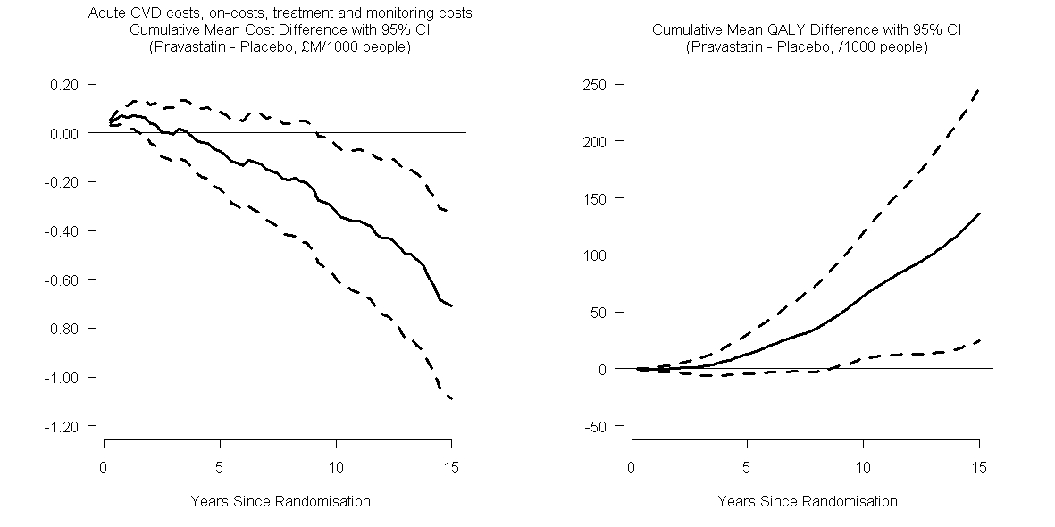
COSTS and QALYs

Slide 24
Benefits over 15 years
5 years treatment of 1000 patients would
  save the UK NHS £ 710,000 ( >$1m)
  gain 136 QALYs
  prevent 1836 days in hospital
  result in no excess in non-CV admissions/costs

Slide 25
Incident Cancers in
the PROSPER trial
 | Within-trial |  | Post-trial |  | Overall
 | Placebo | Pravastatin | Placebo | Pravastatin | Placebo | Pravastatin
N | 2913 | 2891 | 2543 | 2501 | 2913 | 2891
Incident cancers | 191 | 230 | 346 | 340 | 537 | 570
HR (95%CI) |  | 1·23 (1·01 - 1·49) |  | 1·00 (0·86 - 1·16) |  | 1·08 (0·96 - 1·21)
P |  | 0·038 |  | 0·95 |  | 0·22

Slide 26
Some challenges
Regulatory authorities
  eg SAE reporting
Need for a national prescribing/dispensing dataset
Timeliness of data availability
  challenge of acute studies
Incompleteness and quality of phenotype

Slide 27
What are industry doing
Electronic records for clinical research
  EU IMI project
  Aims to build a European platform to
      support feasibility assessment
      facilitate recruitment
      facilitate data acquisition in follow-up

Slide 28


